Slide 1
PIZZA ORDERING SYSTEM
Tejaswi Ayyadapu
Anusha Jasti
Sumanth Sanakkayala
Nikhil Sanka

Slide 2
Motivation
The main motive of our project is to test to which extent the ACID properties hold for a particular system.
The bank would be a perfect example, which we are already working on in classes. So we thought a Delivery system would be better to work on.
We choose to go with the Pizza Delivery System in particular

Slide 3
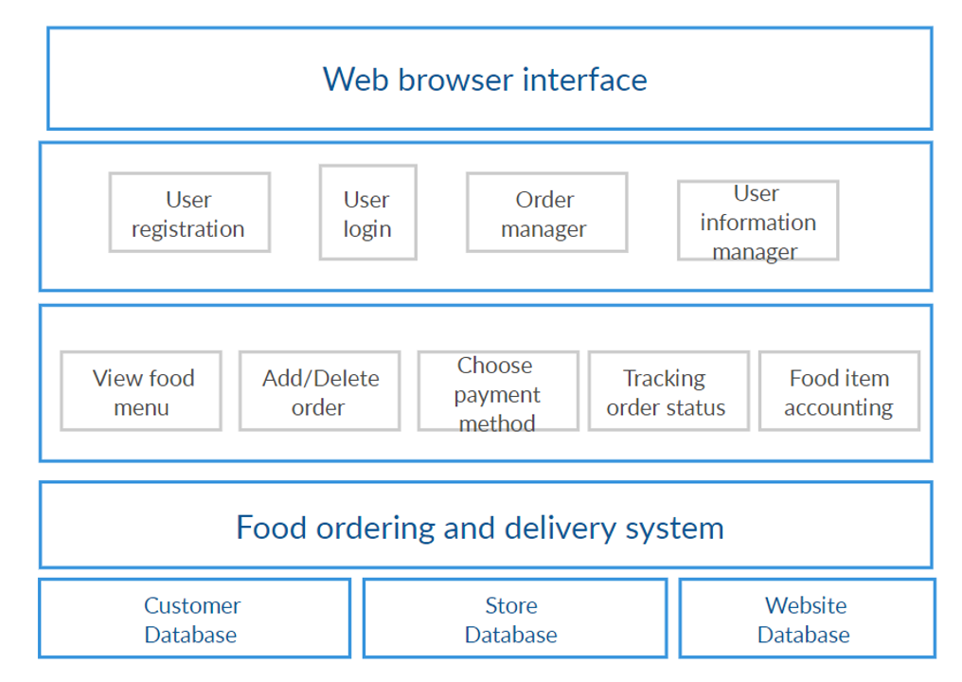
ARCHITECTURE

Slide 4
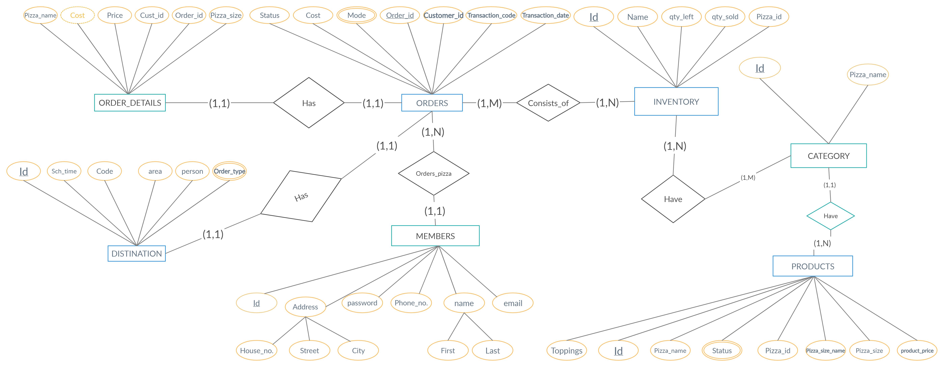
ER-DIAGRAM

Slide 5
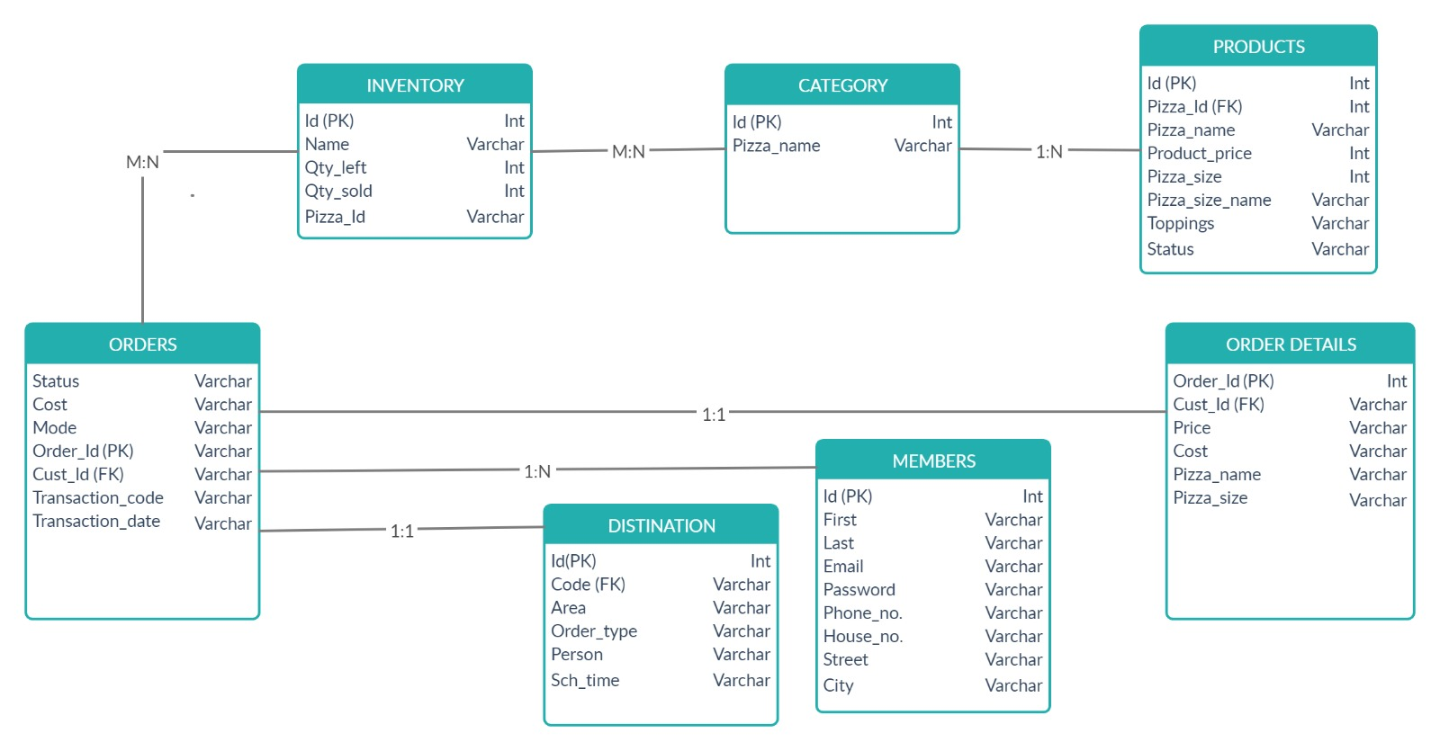
SCHEMA DIAGRAM

Slide 6

Requirements
This software developed can be run on any OS platform.
We are developing the user interface using HTML, CSS and PHP while the backend which is the database is being developed using MySQL for storing and processing the data.
XAMPP
MYSQL

Slide 7
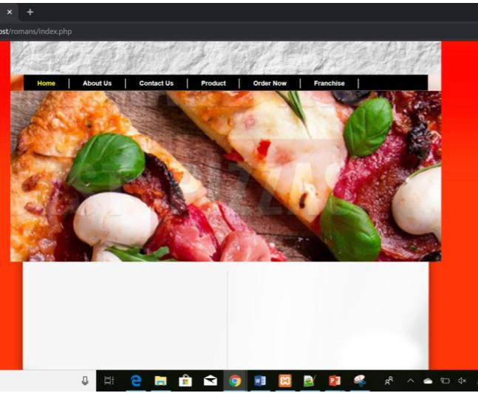
SCREENSHOTS-HOME PAGE
Home page displays the starting page of the system

Slide 8
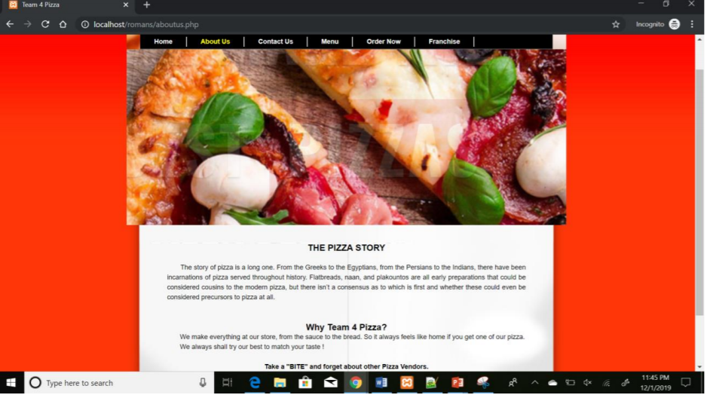
About us page

Slide 9
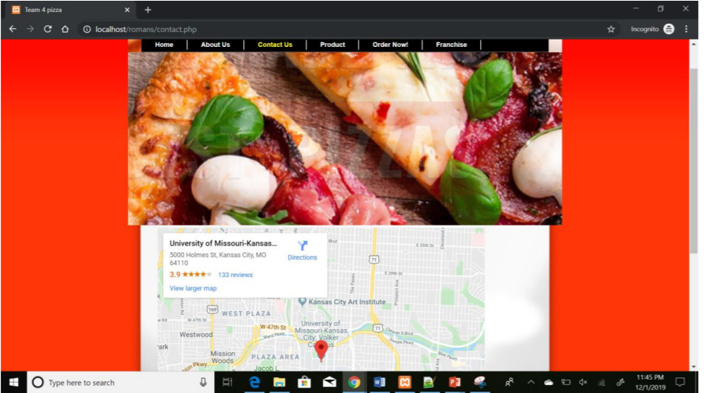
Contact us frame

Slide 10
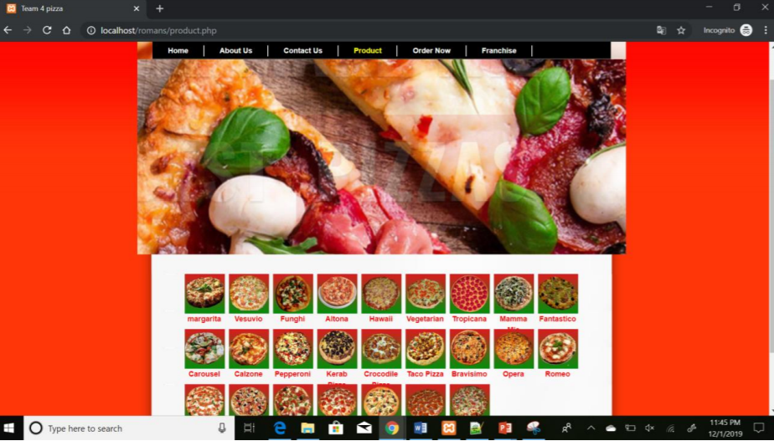
Products frame

Slide 11
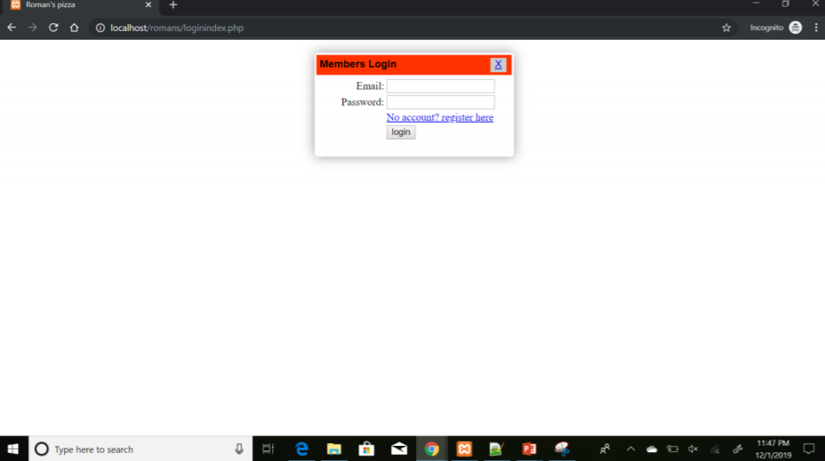
Login page

Slide 12
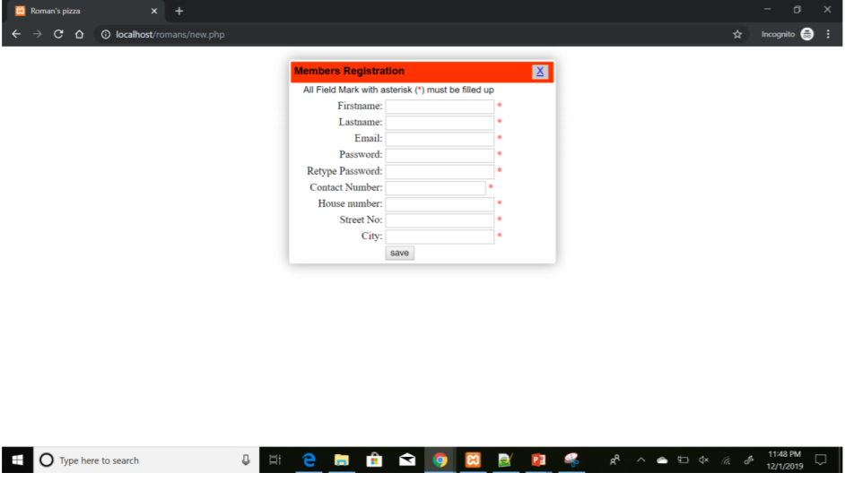
Register page

Slide 13
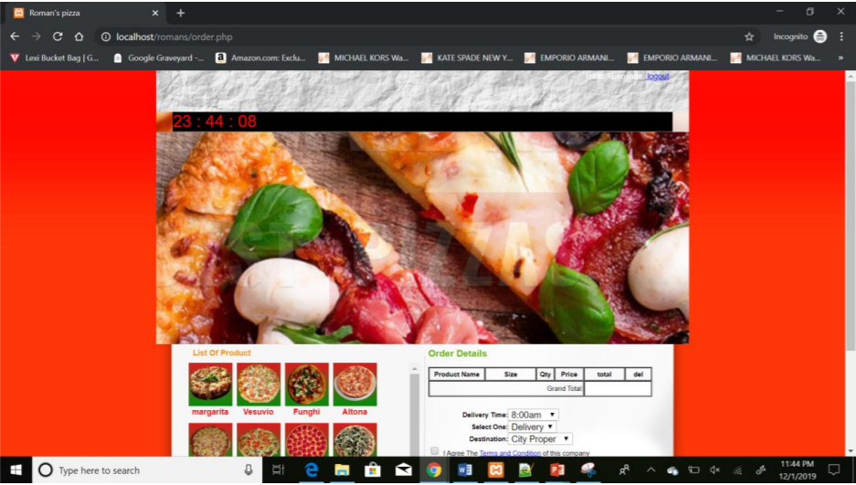
After login-pizza products page

Slide 14
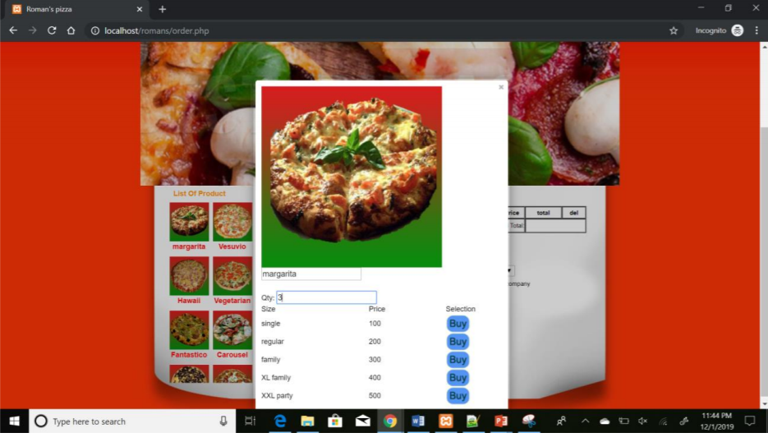
PIZZA selection frame

Slide 15
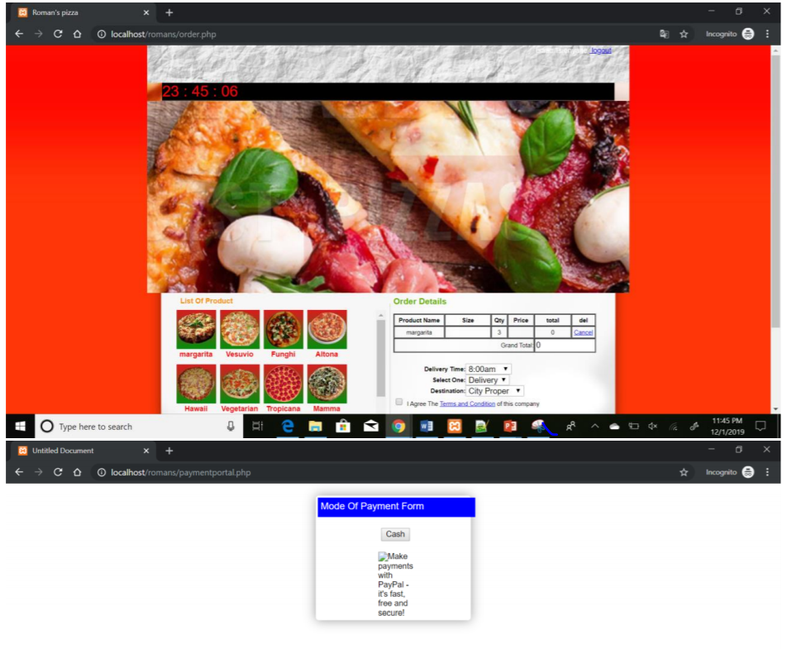
Payment mode page

Slide 16
Constraints
DOMAIN CONSTRAINTS :
1. After the order is confirmed, it cannot be cancelled or the items in the orders cannot be edited.
2. The payment can be done either by cash or the customer can do it online through paypal.
3. There must be a valid time difference between the time of order placement and the pick-up time.

Slide 17
Key Constraints
1. The customer should have a PayPal account to make an online payment for the order.
2. Constraint check for 10 digit character use for postal code in the phone number.
3. Neither the first name, nor the last name of the customer in the personal details section can be null.
4. Transaction id must be unique.
5. E-mail Constraints –
a) E-mail must have at least one character before the @ ;
b) E-mail must have at least two characters between @ and . ;
c) E-mail must have at least two characters between ‘.’ and the end.

Slide 18
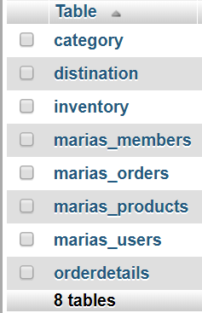
Database details
We are using the Maria DB to store the details.

Slide 19
DRAWBACKS
The customer cannot get to know the status of the order.
The payment is not verified.
User cannot create a customized pizza.
User can only place order within the city limits and outskirts, but not in any other city.

Slide 20
FUTURE SCOPE
• Include the delivery details which consists of the details of the driver and the customer.
• We could provide services like real time tracking of the order from the customer side.
• We could improvise the payments by including authorized credit and debit card payments.
• Real time notifications of the order status.
• Could develop Application in both Android and iOS.

